Slide 1

TASK ASSIGNED DURING THE TENURE OF FELLOWSHIP
NAME : PRANAV PRAKASH
DESIGNATION : JUNIOR RESEARCH FELLOW
Sl. No. | Task Assigned
1. | Development of Fitment Tester/ Leak Tester Mk-II: for NBC Respirator
2. | Software development of Test Jig (Test Simulator) for ECU
3. | Preparation of User Manual & Animated Video Presentation for Fitment Tester/Leak Tester Mk-II:
4. | Additional Technical and Research activities

Slide 2

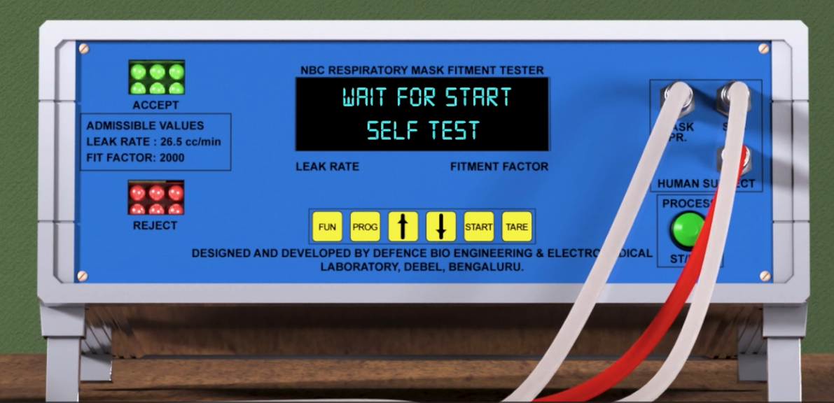
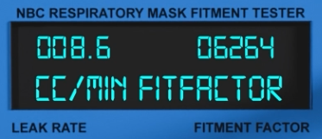
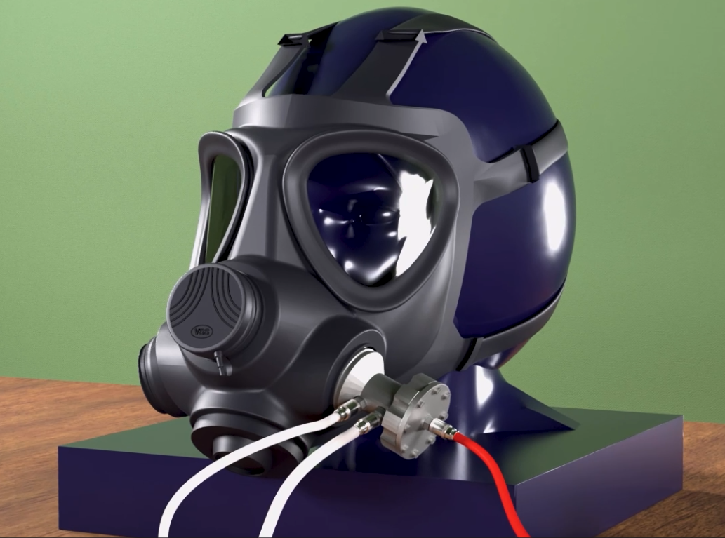
Development of Fitment Tester/ Leak Tester Mk-II: for NBC Respirator
CAUSE OF INVENTION:
NBC respirators, designed to protect wearers from inhaling pollutants and toxic gases but due to variability in facial dimensions of every personnel determining the right fit of NBC respirator is a major challenge.
Fitment Tester/ Leak Tester Mk-II
Varying Facial Dimensions
Final Result
FUNCTION:
FT/LT Mk-II assesses multiple pneumatic parameters to determine if the respirator is suitable for use in NBC environments.
Equipped with provisions to test NBC mask’s available worldwide with external canister ports.
Capable to generate quick and reliable results irrespective of geographical locations.
NBC Mask with Canister Port

Slide 3
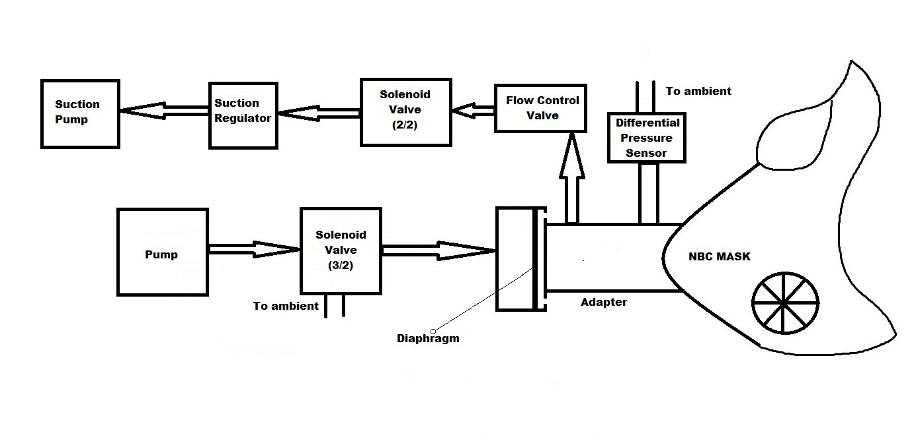

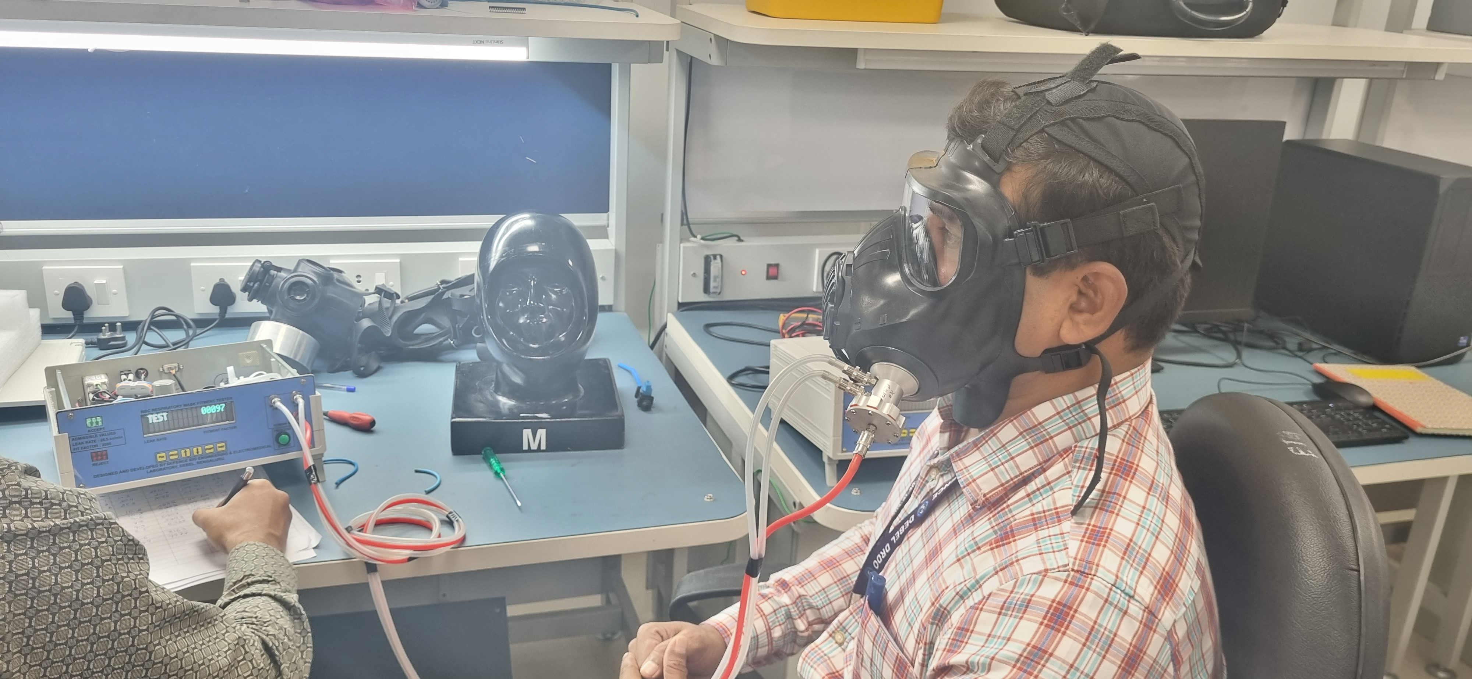
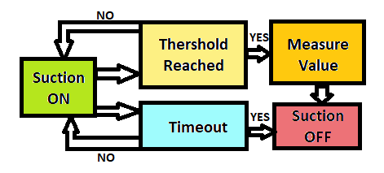
Development of Fitment Tester/ Leak Tester Mk-II: for NBC Respirator
MY CONTRIBUTIONS:
Designing of Pneumatic Circuit
Literature survey to determine NBC parameters.
Execution of “Water Fill Test” in order to determine in-mask effective volume.
Development of Software Algorithm.
Pneumatic Block Diagram
User Trials
International Standard
Algorithm

Slide 4
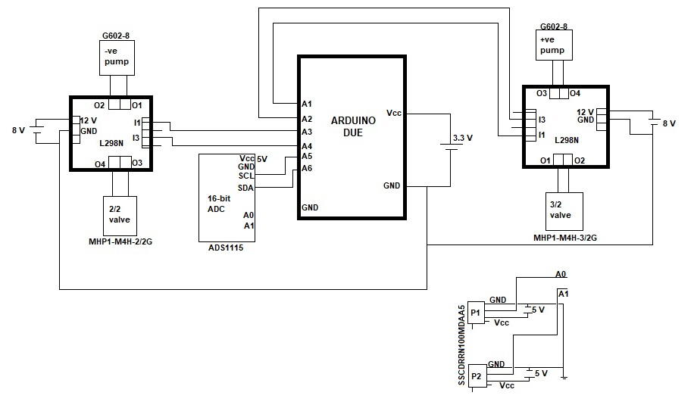
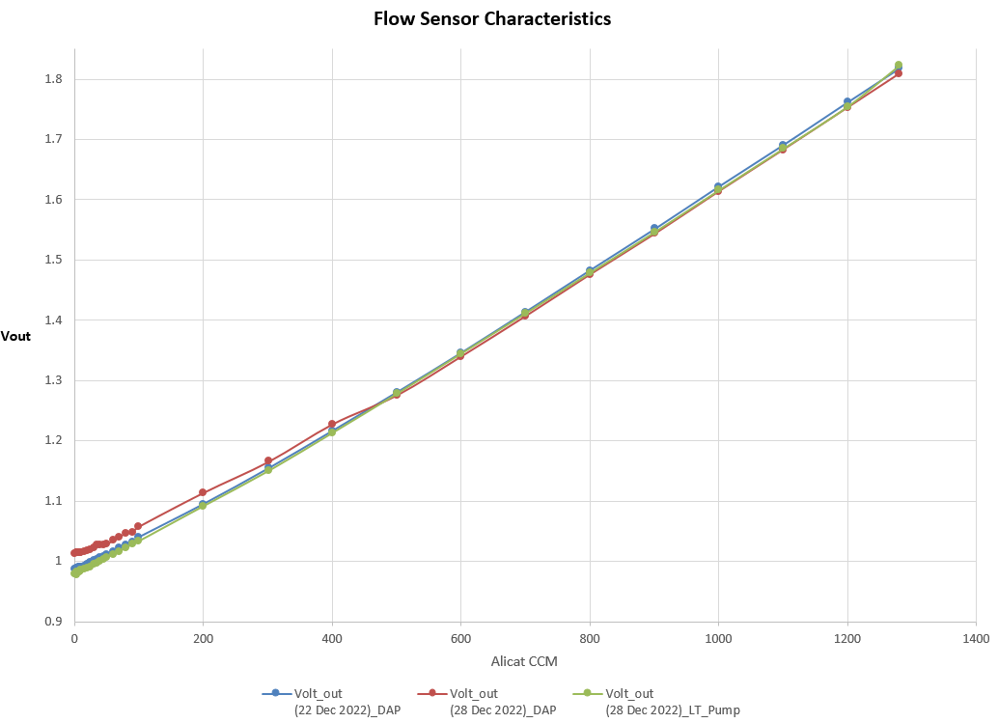
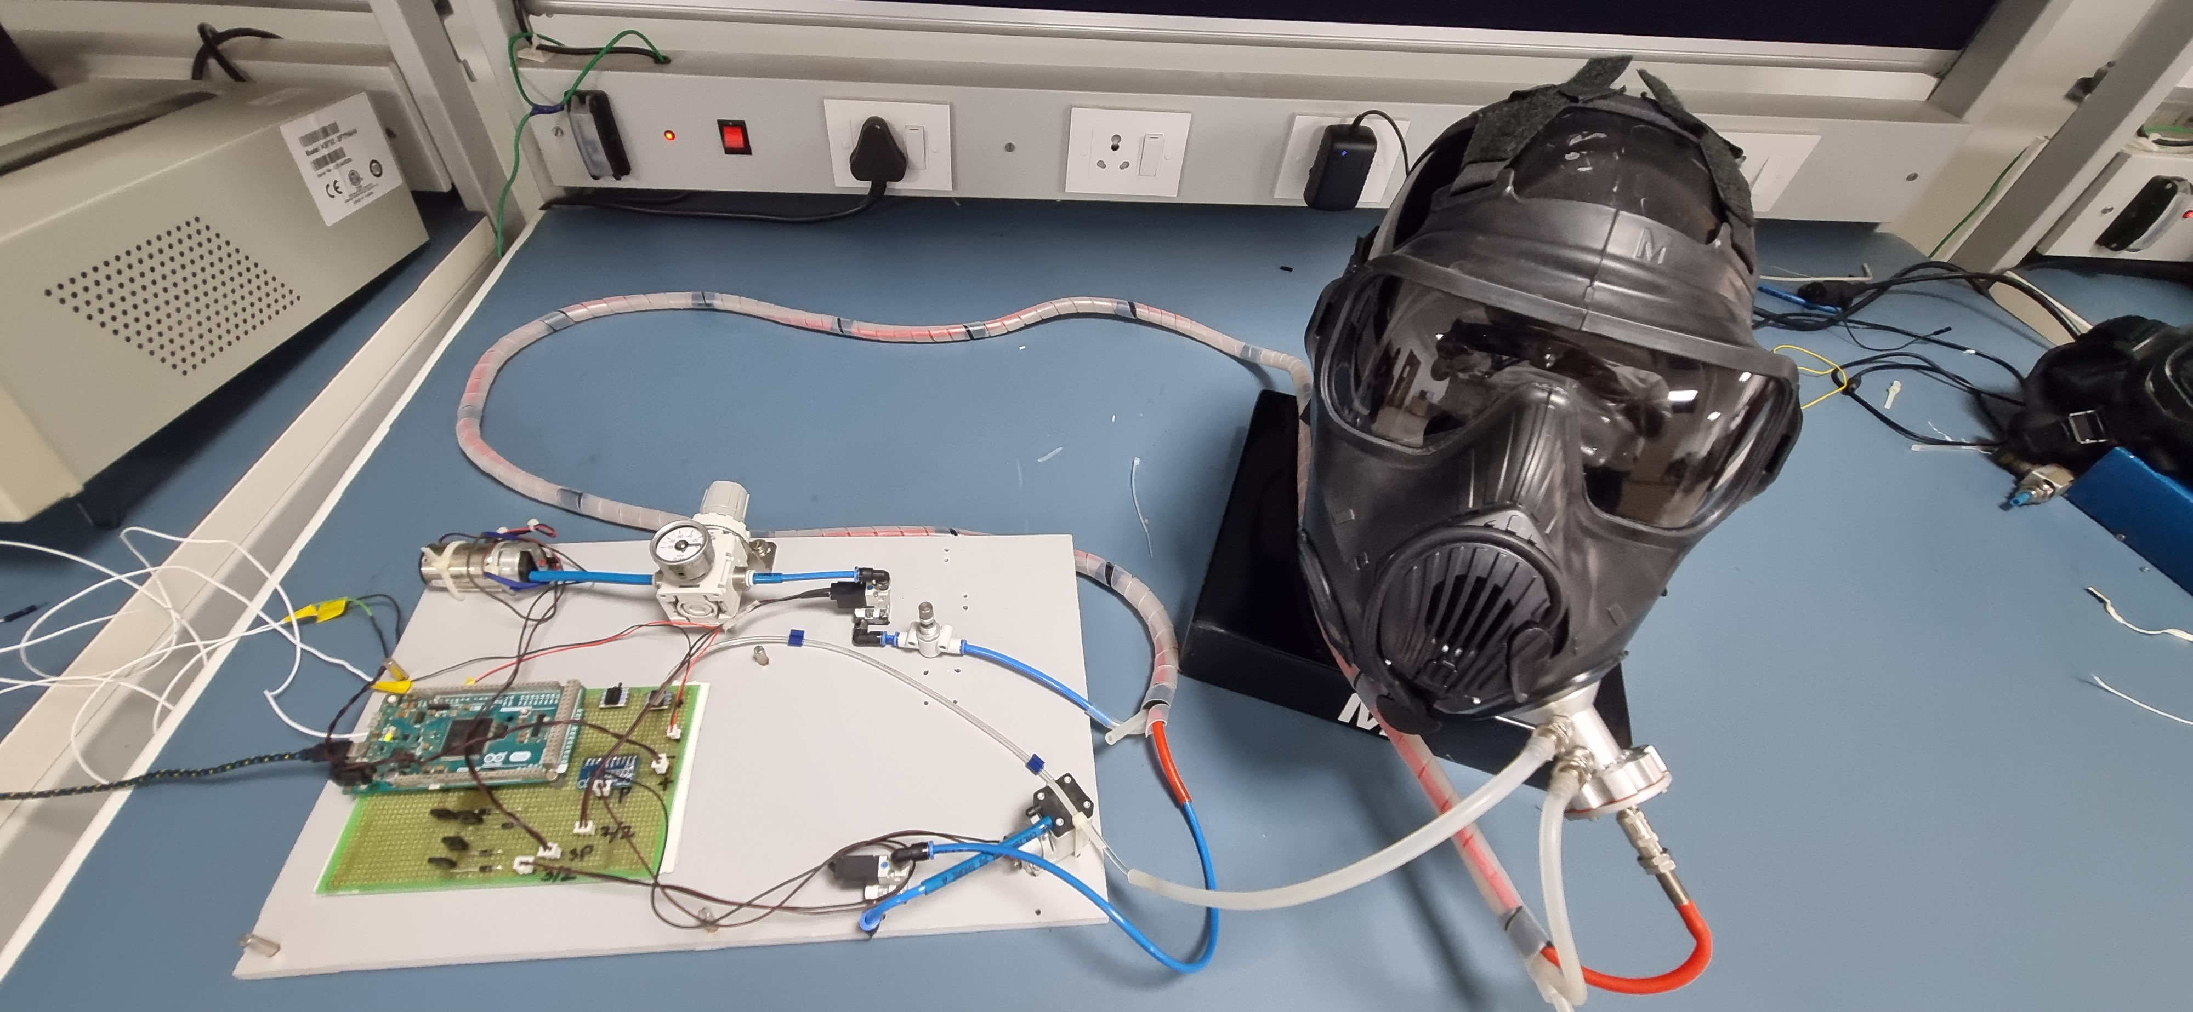
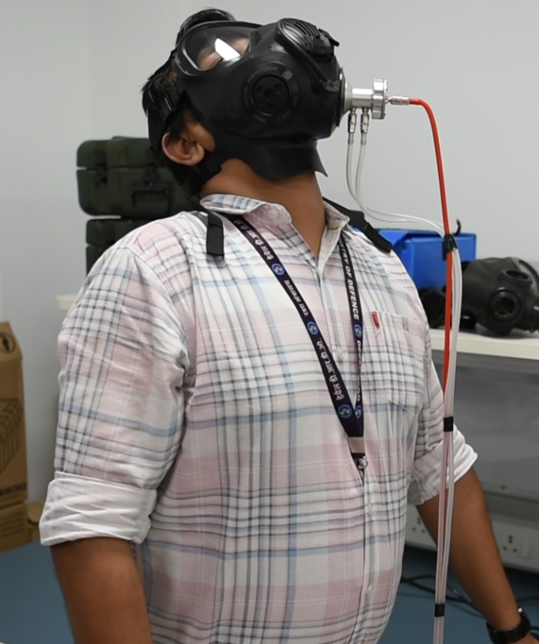
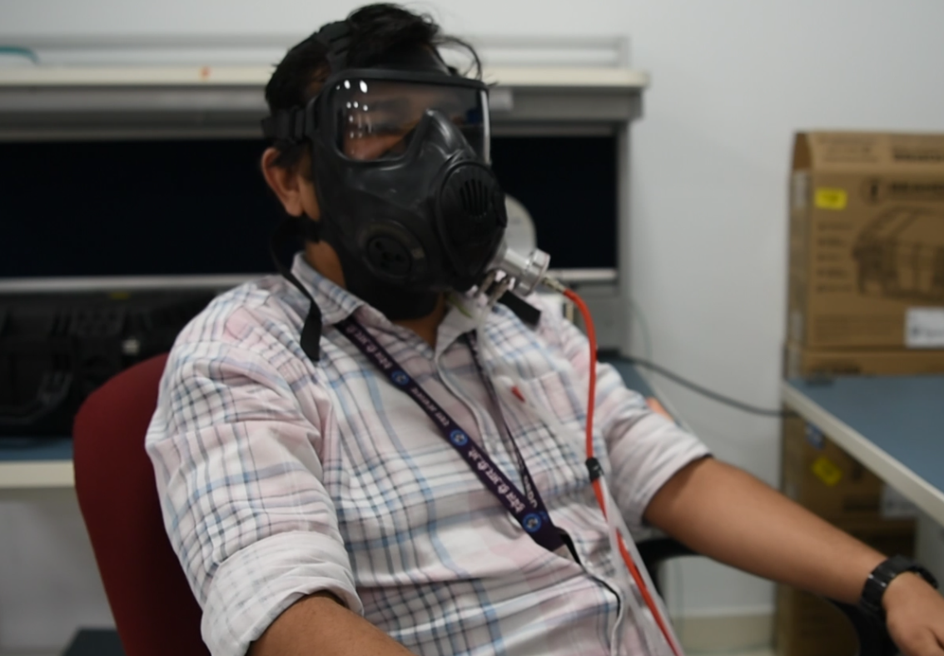
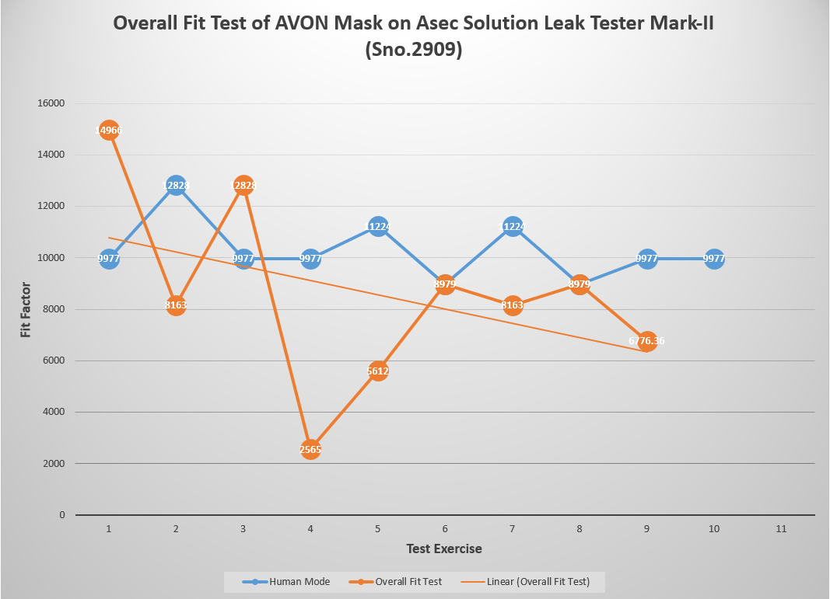
Development of Fitment Tester/ Leak Tester Mk-II: for NBC Respirator
MY CONTRIBUTIONS:
Characterisation of multiple transducers.
Interfacing of transducers with the system.
Designing & software simulation of electrical circuit.
Programming of FT/LT Mk-II microcontroller.
Assembling of electronic circuit.
Multiple user trials conducted and data recorded
Vout v/s FLOW
Characterisation
Electronic Circuit
FitFactor v/s Exercise
Overall Fitment Test
Test Data
Prototype FT/LT Mk-II

Slide 5
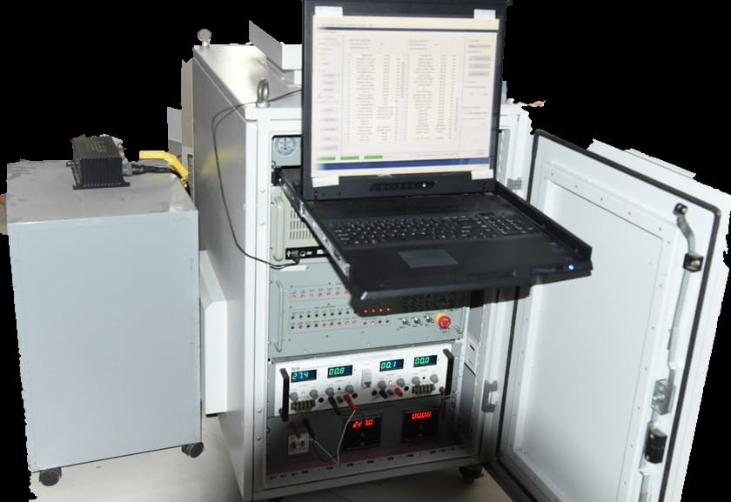
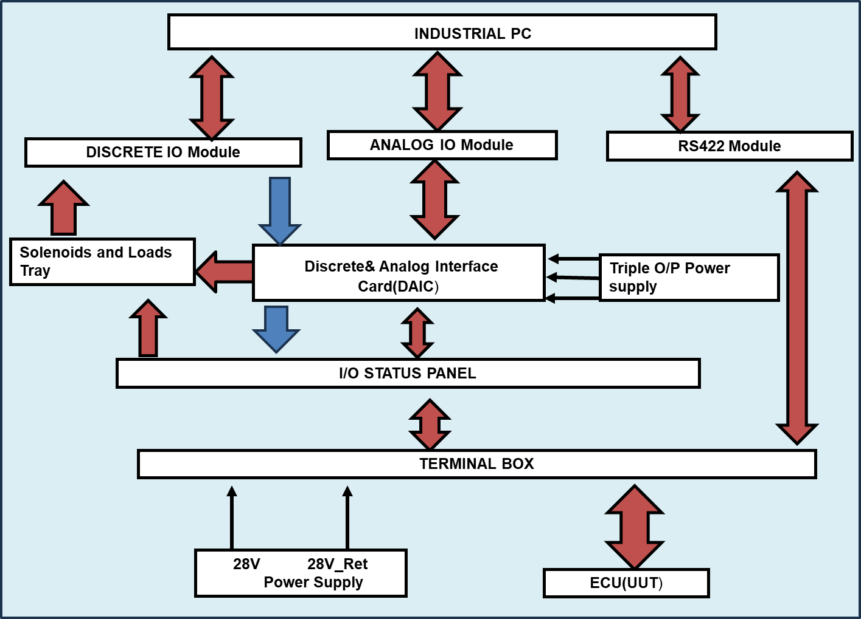
5
Software development of Test Jig (Test Simulator) for ECU
CAUSE OF INVENTION:
Electronic Control Unit (ECU) is the main computer of ILSS to interact and provide status information to the pilot.
In order to verify functional correctness of ECU lab based test simulators needed to be designed.
Testing of ECU with Test Rig
FUNCTIONS:
Provides complete interface simulation for functional testing of the ECU.
Implementation of pilot MFD for more user friendly experience.
Software and hardware provisions for easy future reconfiguration.
Test Rig Block Diagram

Slide 6
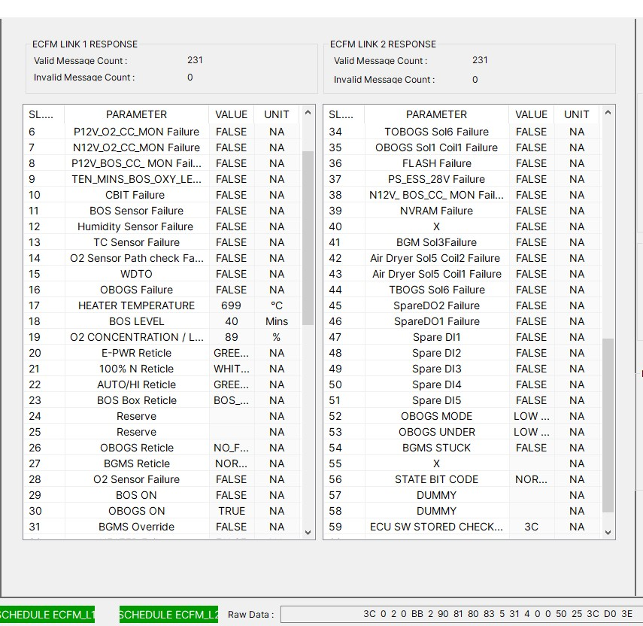
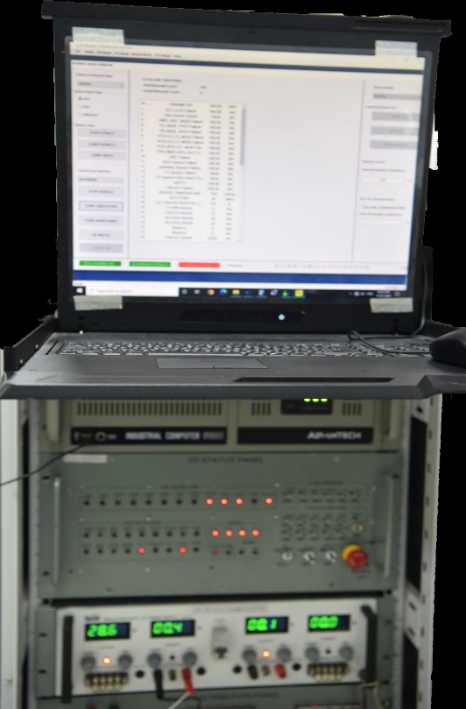
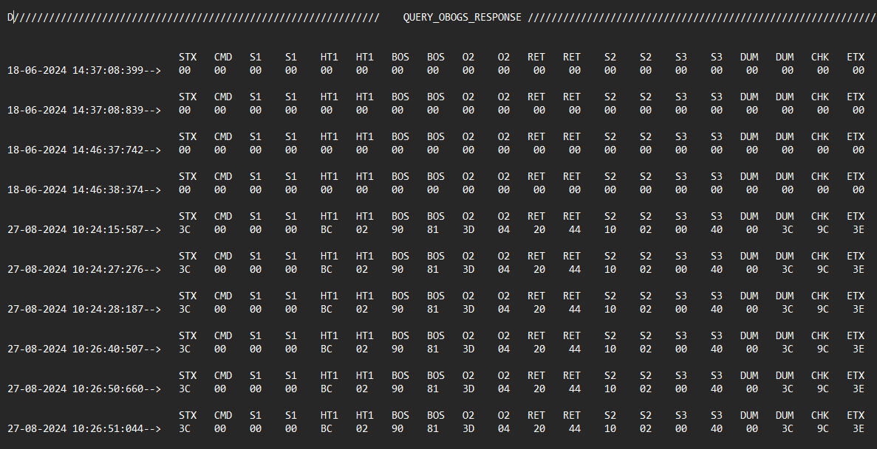
Software development of Test Jig (Test Simulator) for ECU
MY CONTRIBUTIONS:
Rectification of multiple software issues like:
Communication Card installation.
Implementation of Vk-7 switch
Provisions for data logging
ECU Parameters as per IPD
Updated parameters as per the latest IPD
Resolved ECU flickering between multiple states of operation.
Alignment of dual channel communication line with that of actual A/c
Proper execution of exception handling.
Test data log

Slide 7
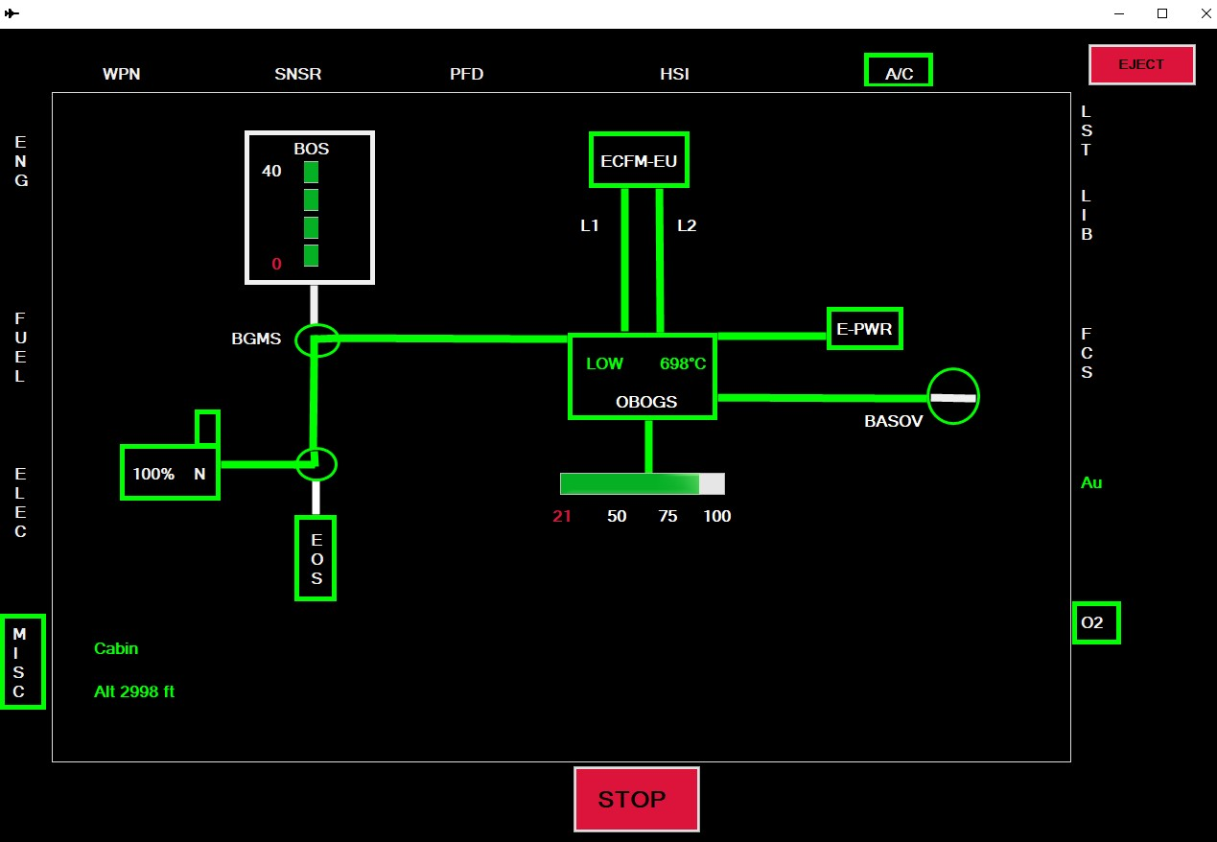
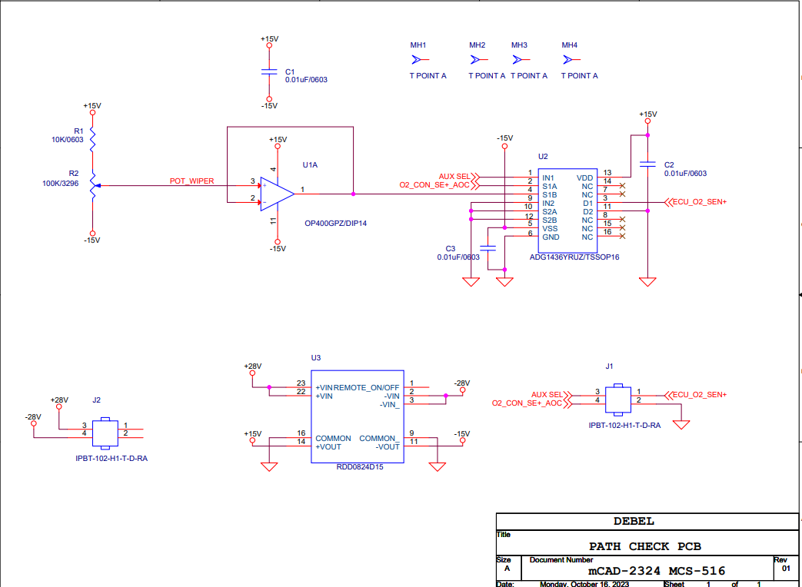
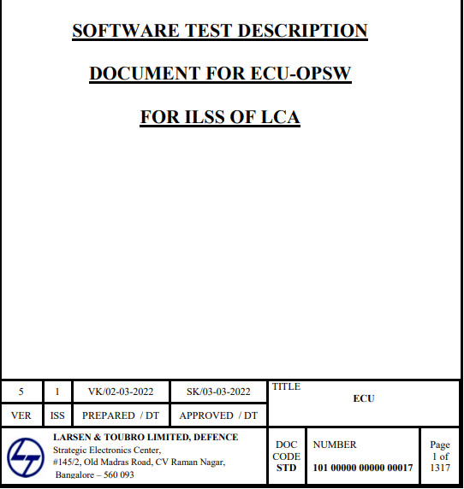
Software development of Test Jig (Test Simulator) for ECU
MY CONTRIBUTIONS:
Designing of O2 path check circuit
Interfacing of O2 path check PCB
Implementation real time responsive O2 MFD
Introduced GCS and LPOST mode of operation.
Performed simulation of functionality test through Software Test Document (STD) and ATP document.
Pilot MFD
STD Manual
O2 Path check Circuit

Slide 8
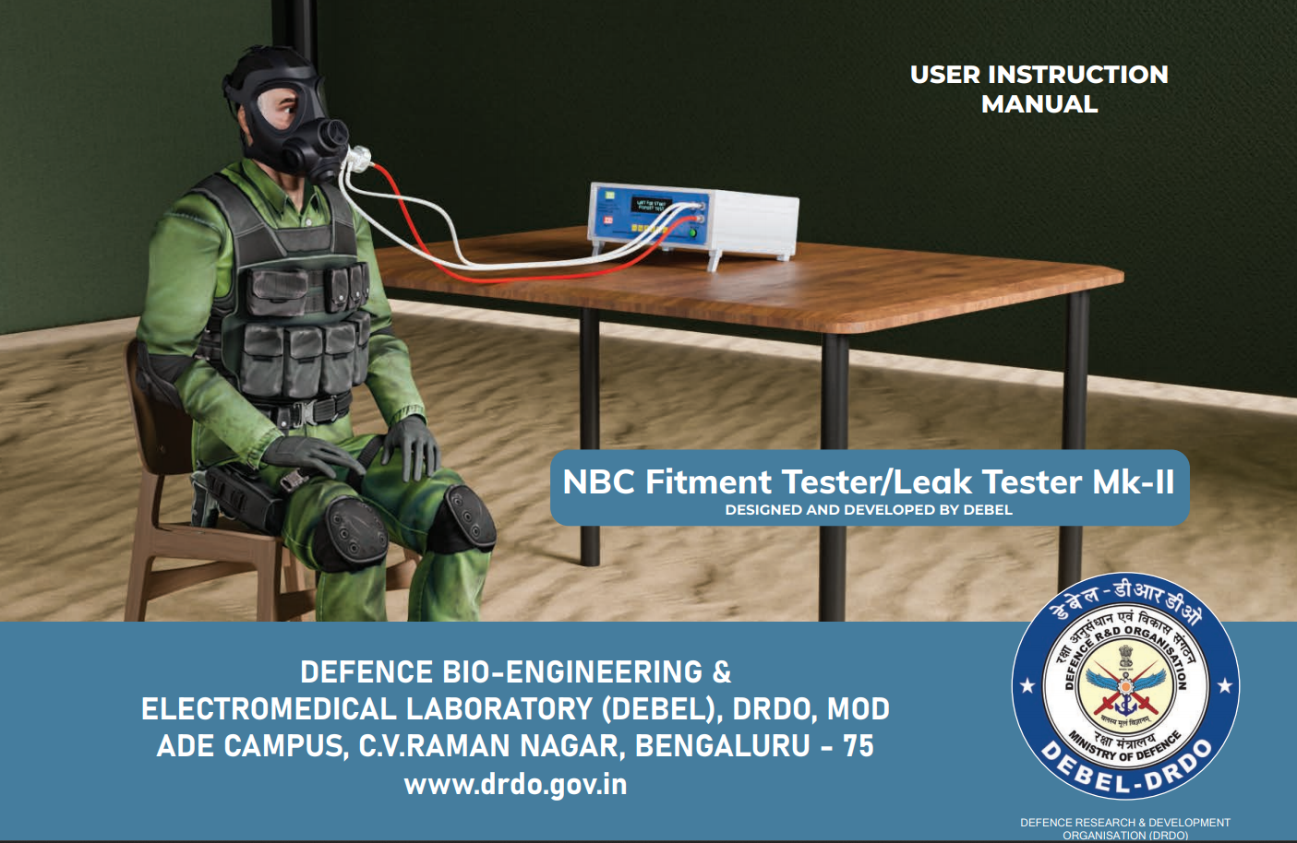
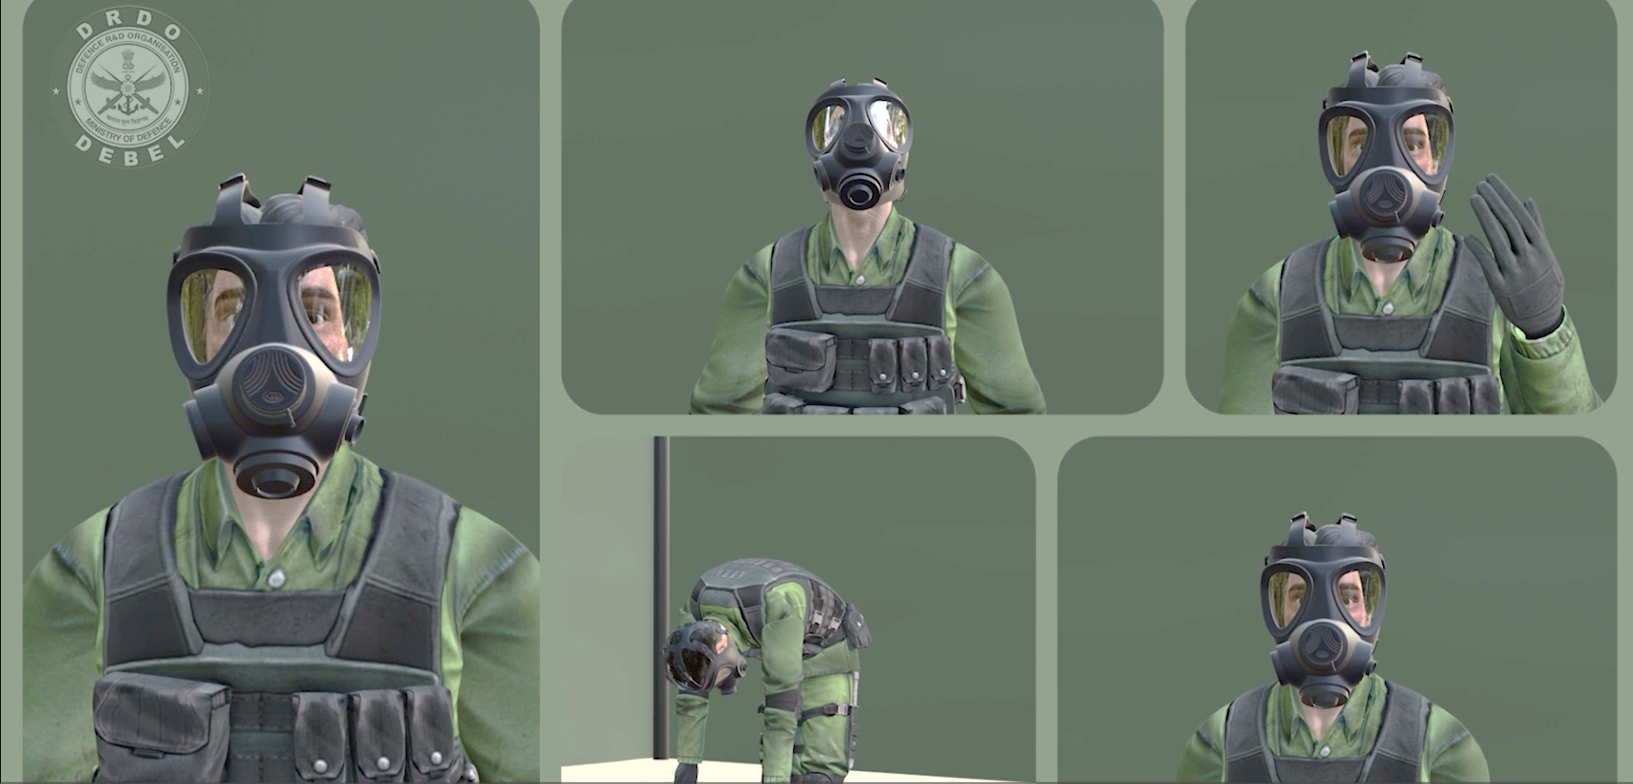
Preparation of User Manual & Animated Video Presentation for FT/LT Mk-II:
MY CONTRIBUTIONS:
Performed rigorous literature survey in order to validate the contents to be included in the manual.
Preparation of the draft for the literature content of the manual.
Performed regular checks and verification and suggested necessary actions for content rectification.
Took part into multiple discussion sessions to guide them on how to proceed ahead with the animation video.

Slide 9
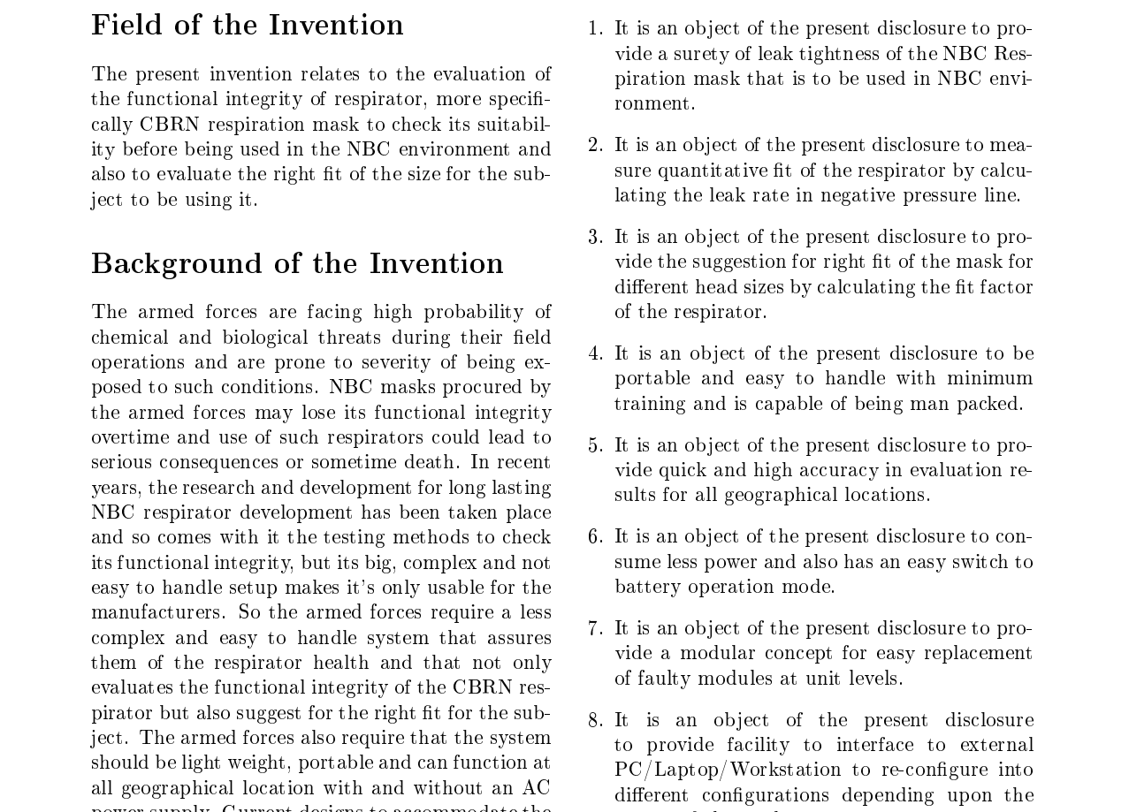
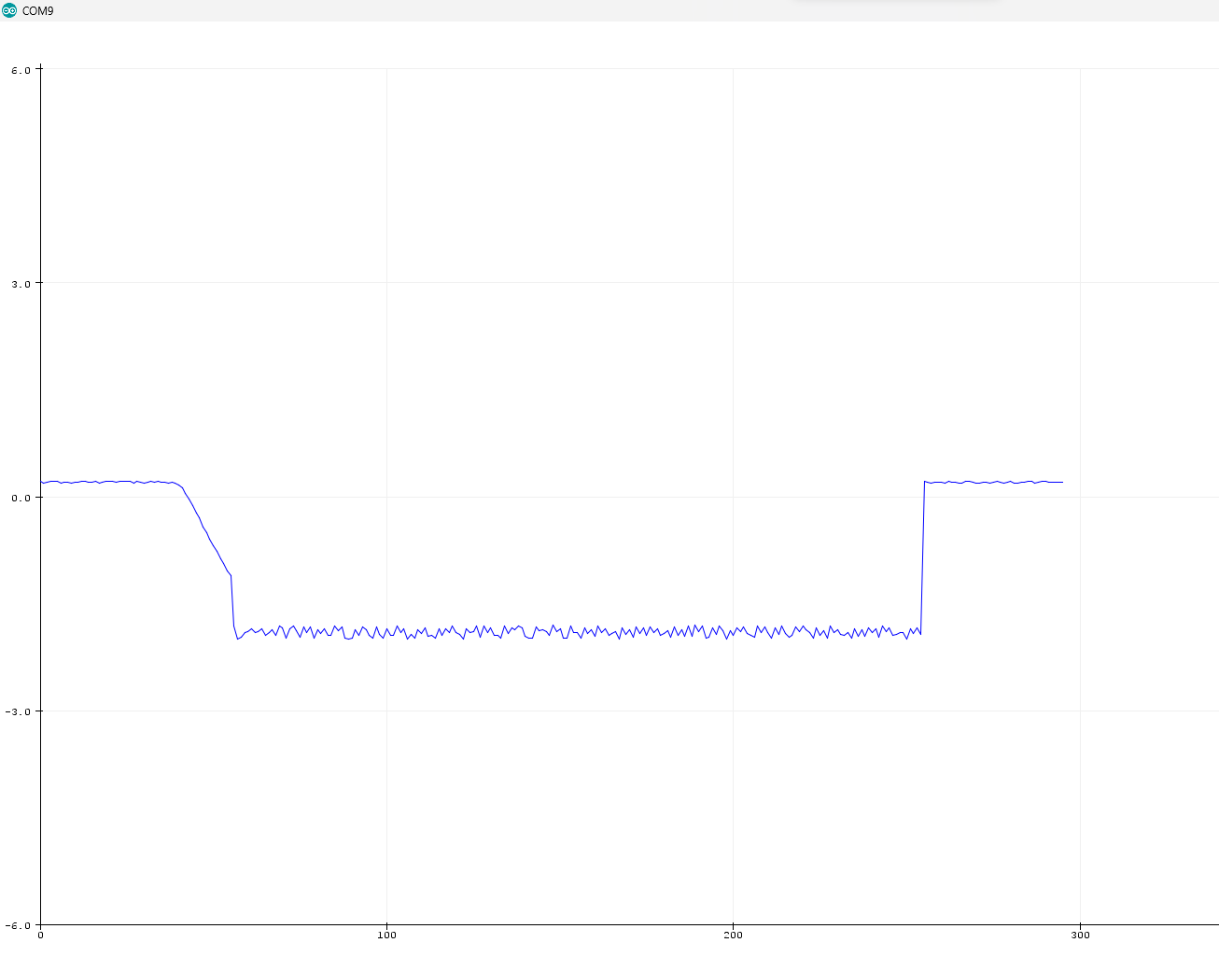
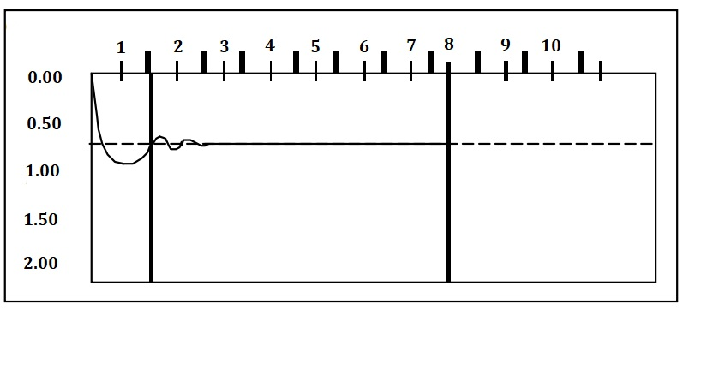
Additional Technical and Research activities
8
OTHER RESEARCH CONTRIBUTIONS:
Succeeded in developing a new algorithm for NBC Fitment Testing
i.e. Controlled Negative Pressure (CNP).
Performed transducer interfacing with the DAC system in High Altitude Chamber.
Preparation of design patent document of FT/LT Mk-II.
CONTROLLED NEGATIVE PRESSURE
Negative Pressure v/s Time
Negative Pressure v/s Time
v/s
PATENT DRAFT
PRACTICAL
THEORITICAL

Slide 10
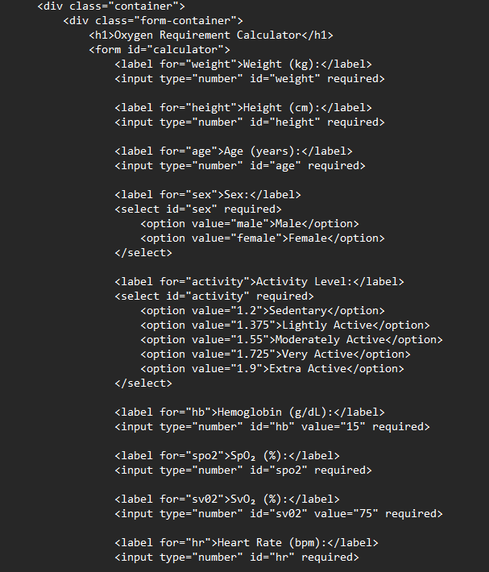
FUTURE PLANS
Electro mechanical system modelling and simulation studies.
Complete software development of FT/LT Mk-II for technology transfer (ToT) activities.
Development and certification of Test jig under upcoming project for ILSS for LCA AF Mk-II.
THANK YOU
SIMULATION MODEL

